Slide 1
MDM Performance Tuning

Slide 2
AGENDA
Best Practice For Performance Tuning

Slide 3
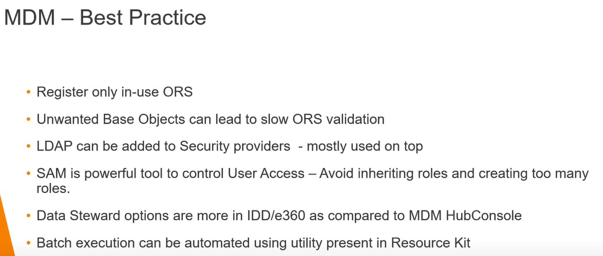
Background
MDM
Performance
Tuning:

Slide 4
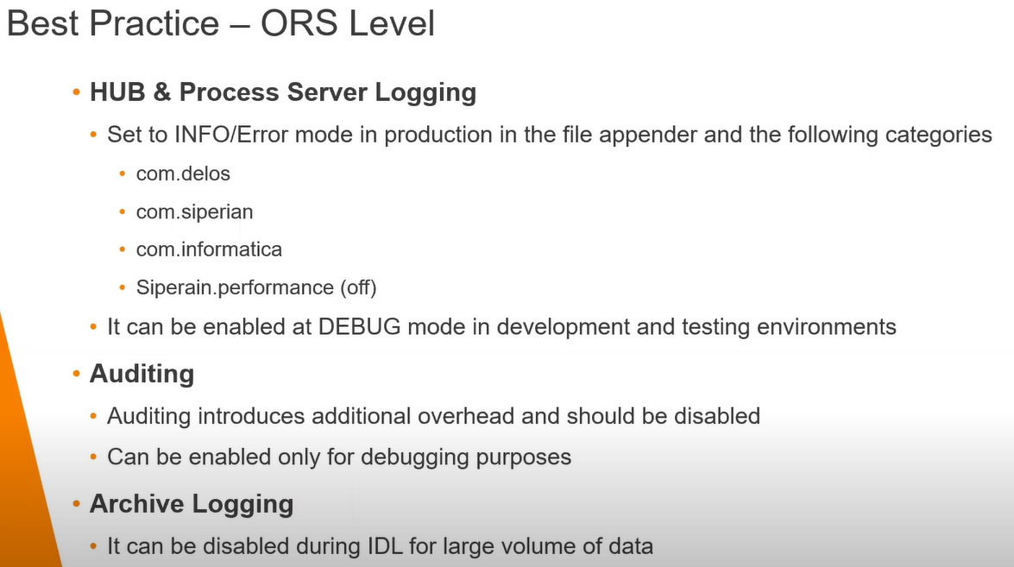
Background
MDM
Performance
Tuning:

Slide 5
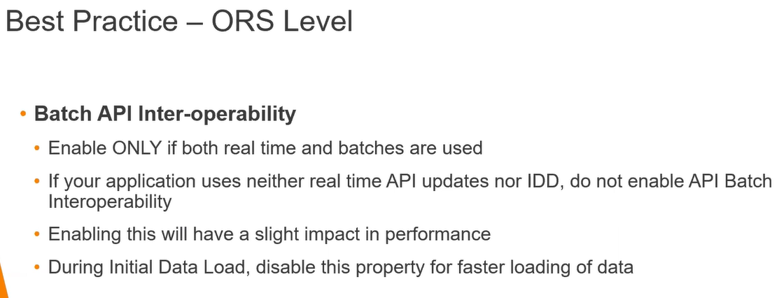
Background
MDM
Performance
Tuning:

Slide 6
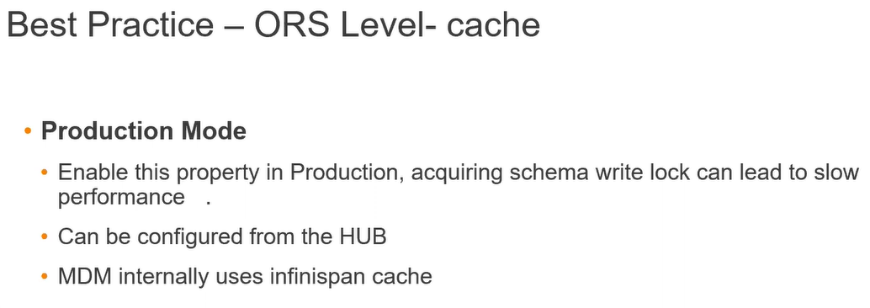
Background
MDM
Performance
Tuning:

Slide 7
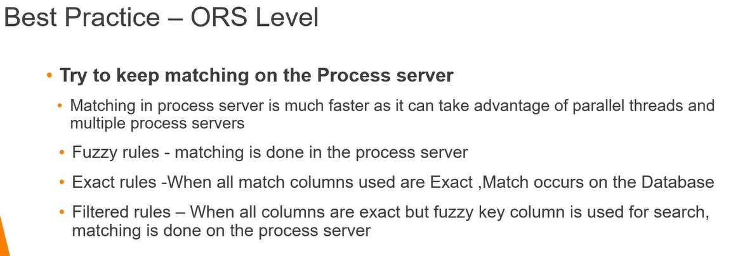
Background
MDM
Performance
Tuning:

Slide 8
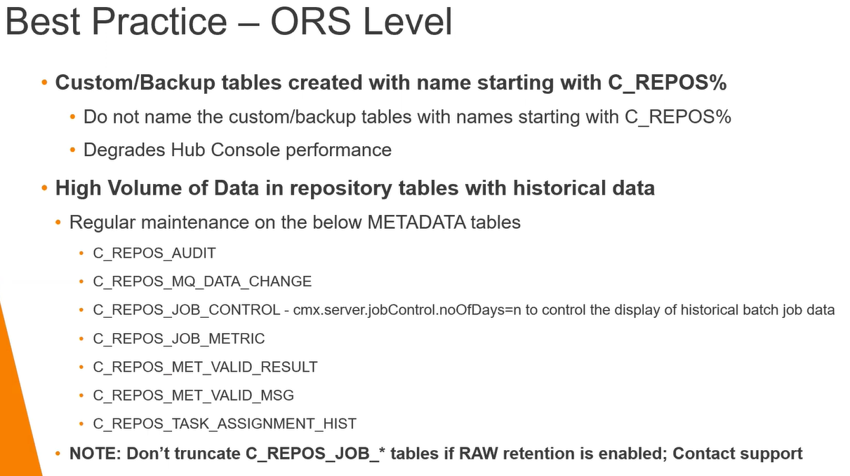
Background
MDM
Performance
Tuning:

Slide 9
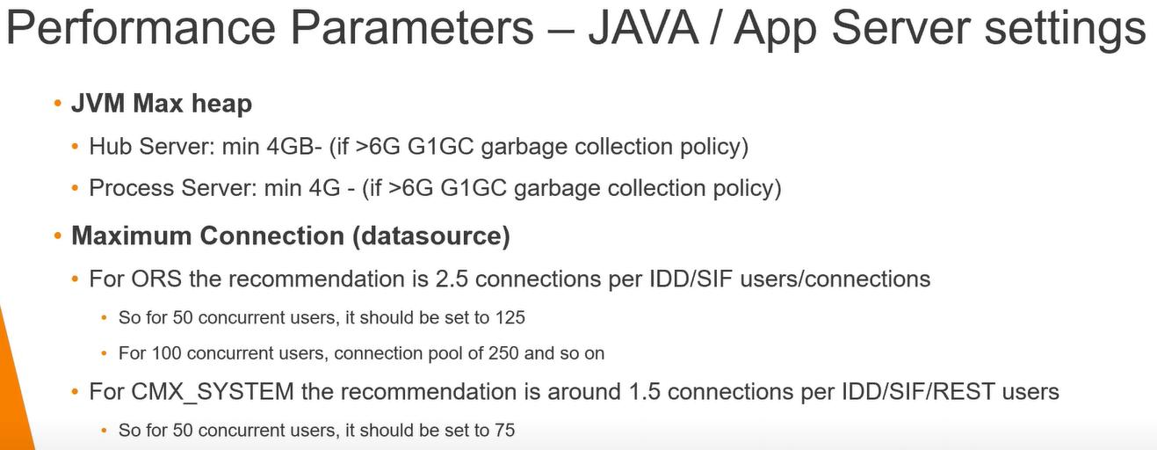
Background
MDM
Performance
Tuning:

Slide 10
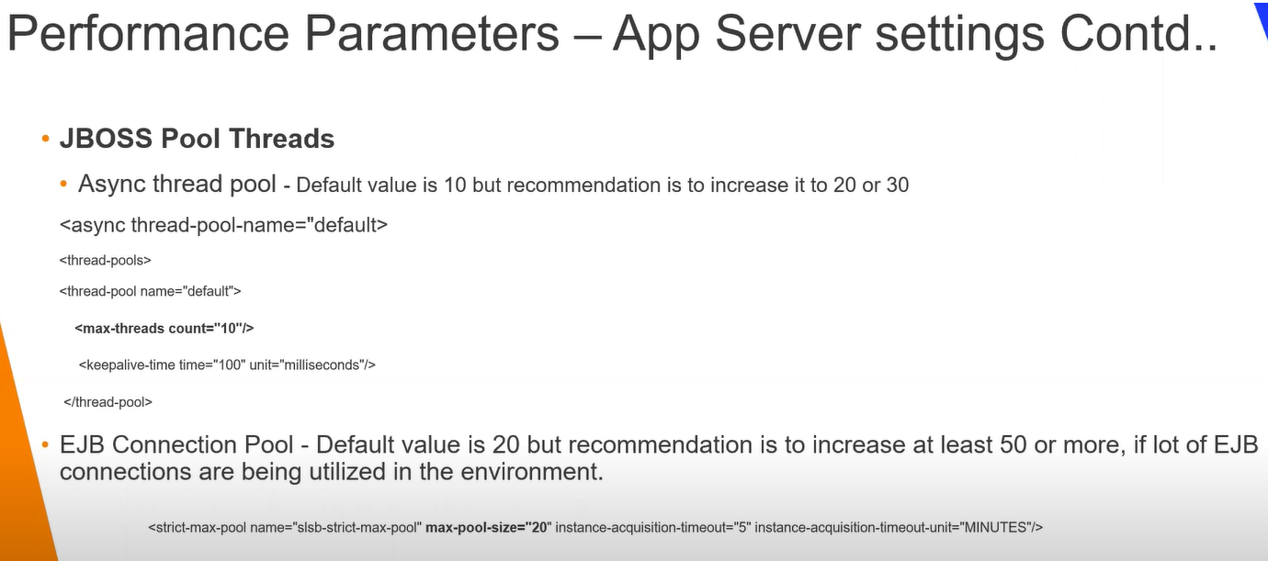
Background
MDM
Performance
Tuning:

Slide 11
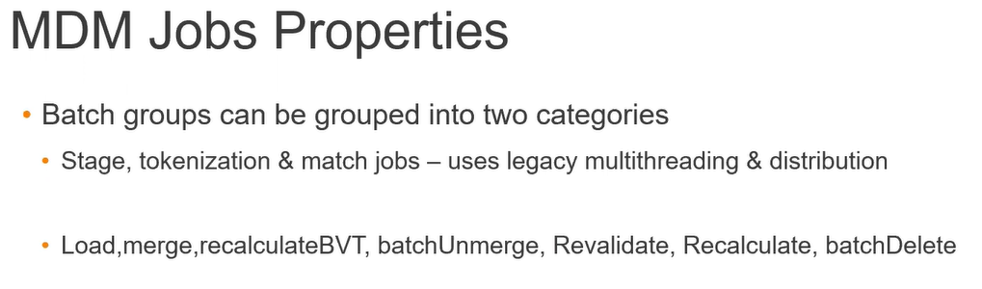
Background
MDM
Performance
Tuning:

Slide 12
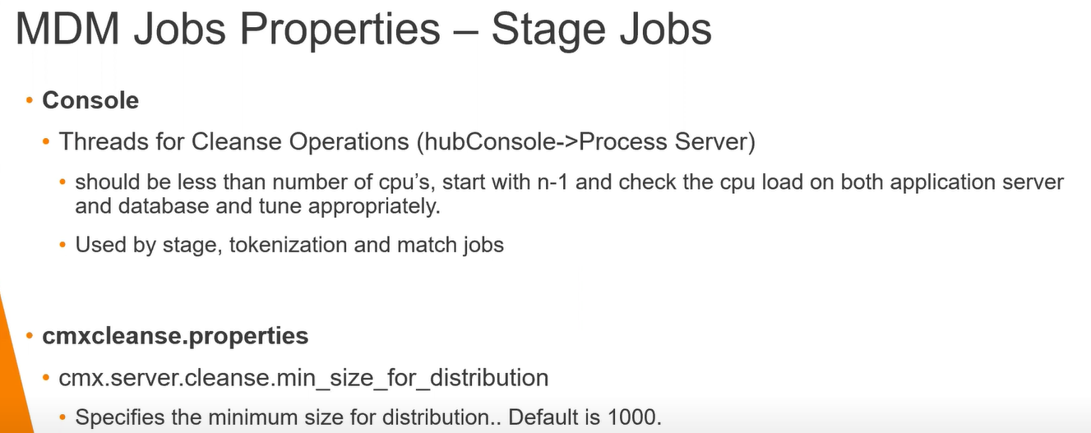
Background
MDM
Performance
Tuning:

Slide 13
Background
MDM
Performance
Tuning:

